Slide 1
Requirements Elaboration
Understanding and analyzing what needs to be built

Slide 2
Elaboration
Some Analysis Techniques
Data Flow Diagram (DFD)
Usecase Diagram
Object Models (ER Diagram, Abstract class diagram, CRC cards)
Decision Tables
State Diagram (Statecharts)
Sequence Diagrams (Message Sequence Charts)
Activity Diagram
Swim-lane Diagram
Flow-oriented, Scenario-based, Class-based, Behavioral

Slide 3
CRC Cards
Class-Responsibility-Collaborator cards
Organizing the classes relevant to system
Organized representation of classes
Responsibilities
Anything a class knows or does
Relevant attributes and operations?
Collaborators
Other classes
From which this class requests some information/some action

Slide 4
Example
We need to develop a game scenario where there can be multiple buildings and roads. There can be different runnable objects on the roads having different colours, number of doors, and number of wheels. Each of the runnable objects can start, stop, and run in its own way. The runnable objects include bicycle, carts, vehicles (like rickshaw, car, van, truck etc.). Each road has a different width, length, curving angle and knows the buildings and their positions on its sides. The buildings know their own positions and have different number of windows and doors. These windows and doors have different dimensions (height, width) and opening mechanism (sliding, pushing). Doors are passable and windows are not. The runnable objects know the road they are running on. The runnable objects are driven by the players (or similar characters in the game) who can use the run, start, stop behaviours of the object when required.

Slide 5
Decision Table
It is a tabular representation of a functional specification that maps events and conditions to appropriate response or action
The specification is formal because the inputs (events and conditions) and outputs (actions) may be expressed in natural language
If there is n input conditions, there are 2^{n} possible combination of input conditions
Combinations map to the same set of result can be combined into a single column

Slide 6
Example
Our university awards upto 100% scholarship to talented students using a University Scholarship Award System (USAS). The university also awards 25% fee waiver on kinship basis using the same system. To award the scholarships, the university maintains very high standards. Students having less than 90% marks in matriculation do not qualify for any scholarship and are given 0% fee waiver . Students scoring 90% or above in matriculation exam are assessed using this program on the basis of their performance in intermediate exam and admission test. Fee waiver is granted as per following rules:
If a student scores 90% or above in intermediate and admission test, grant 100% fee waiver
If a student scores less than 90% in only one of them, grant 50% fee waiver
If a student scores less than 90% in both of them and has valid kinship, grant 25% fee waiver
If a student scores less than 90% in both of them and does not have valid kinship, grant 0% fee waiver

Slide 7
Example
 | Rule 1 | Rule 2 | Rule 3 | Rule 4 | Rule 5 | Rule 6 | Rule 7 | Rule 8 | Rule 9 -16
Marks_{SSC} >= 90% | T | T | T | T | T | T | T | T | F
Marks_{Inter} >= 90% | F | F | F | F | T | T | T | T | -
Marks_{Test} >= 90% | F | F | T | T | F | F | T | T | -
Valid Kinship? | F | T | F | T | F | T | F | T | -
Grant 0% waiver | x |  |  |  |  |  |  |  | x
Grant 25% waiver |  | x
Grant 50% waiver |  |  | x | x | x | x
Grant 100% waiver |  |  |  |  |  |  | x | x

Slide 8
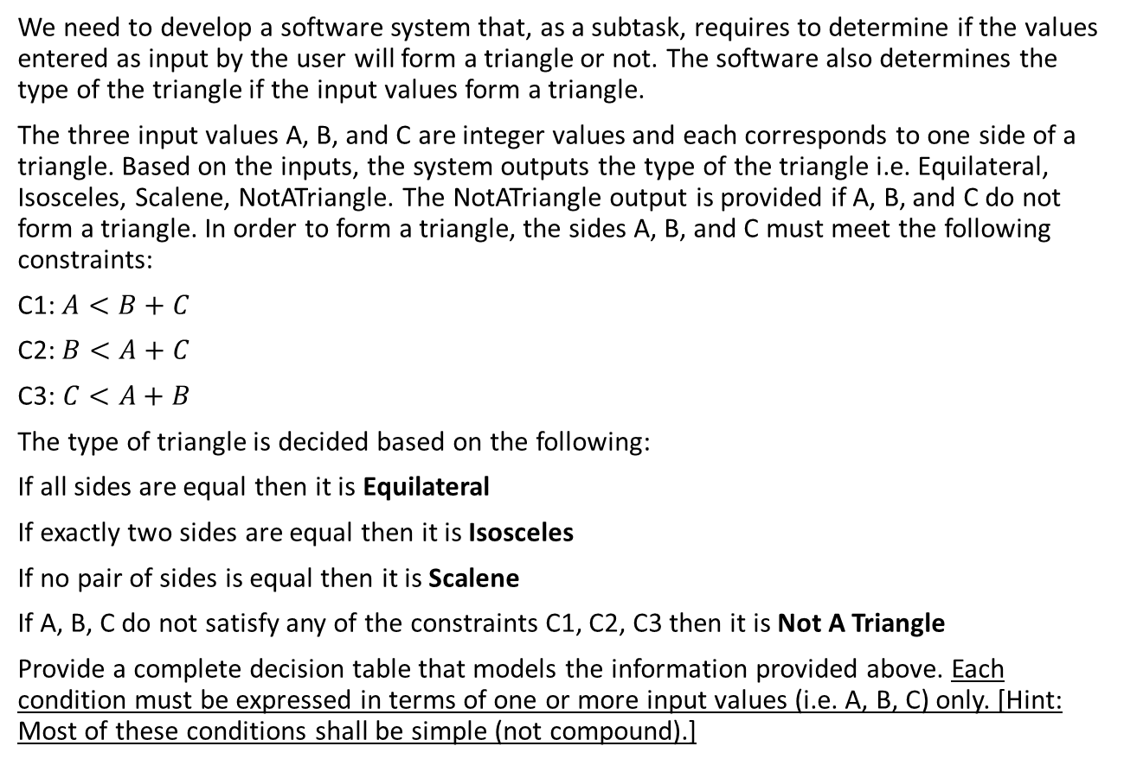
Exercise
We need to develop a software system that, as a subtask, requires to determine if the values entered as input by the user will form a triangle or not. The software also determines the type of the triangle if the input values form a triangle.
The three input values A, B, and C are integer values and each corresponds to one side of a triangle. Based on the inputs, the system outputs the type of the triangle i.e. Equilateral, Isosceles, Scalene, NotATriangle. The NotATriangle output is provided if A, B, and C do not form a triangle. In order to form a triangle, the sides A, B, and C must meet the following constraints:
C1: $A<B+C$
C2: $B<A+C$
C3:$C<A+B$
The type of triangle is decided based on the following:
If all sides are equal then it is Equilateral
If exactly two sides are equal then it is Isosceles
If no pair of sides is equal then it is Scalene
If A, B, C do not satisfy any of the constraints C1, C2, C3 then it is Not A Triangle
Provide a complete decision table that models the information provided above. Each condition must be expressed in terms of one or more input values (i.e. A, B, C) only. [Hint: Most of these conditions shall be simple (not compound).]

Slide 9
Prototyping
“I’ll know it when I see it” –Boehm
Build a prototype and solicit feedback
Not so useful features
Missing functionality
Feasibility of the solution
Exploring multiple options
System aspects that need improvement

Slide 10
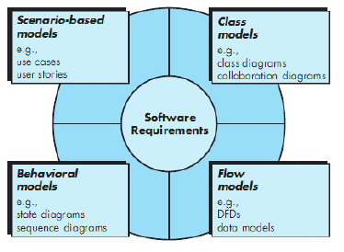
Elements in Analysis Model

Slide 11
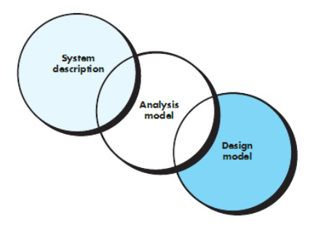
Analysis
Focus on requirements
Each element should improve understanding of requirements
Delay consideration of infrastructure till design
Requirements model provides value to all stakeholders
Keep the models simple

Slide 12
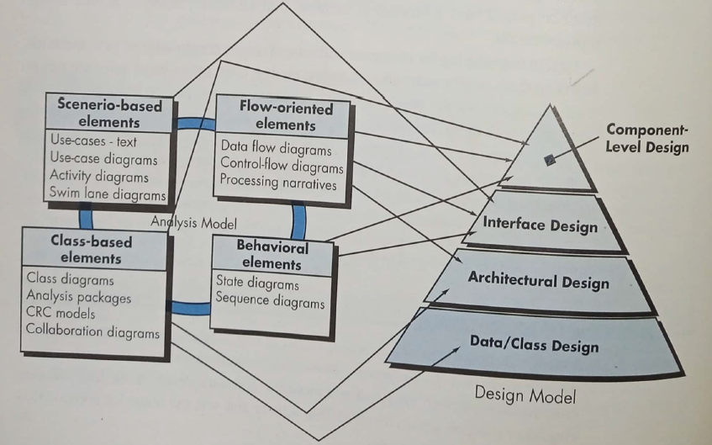
Translating Requirements to Design

Slide 13
Review of Elaboration Techniques
Technique | Category | When?
Data Flow Diagram | Flow oriented | Model data flow
Activity Diagram | Flow + Scenario | Model control flow
Use case Diagram | Scenario based | Model user’s perspective and system features
Swim lane Diagram | Scenario + Flow | Model control flow and participation of multiple actors
Decision Table | Behavioral | Model dynamic aspects of the system
Sequence Diagram | Behavioral | Model Interactions between system components and the actors with the sequence of interactions
Class Diagram | Class/Object based | Model object based static aspects of the system
CRC Cards | Class/Object based | Model object based static aspects of the system
Entity Relationship Diagram | Class/Object based | Model permanent storage based aspects
State Diagram | Behavioral | Model dynamic aspects

Slide 14
Requirements Specification
Documenting what has been understood!

Slide 15
Writing Use Cases
Use a structured format to write a use case
Include primary and alternate scenarios
See document and book

Slide 16
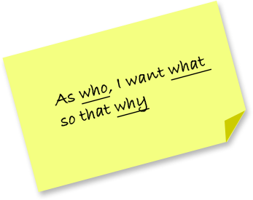
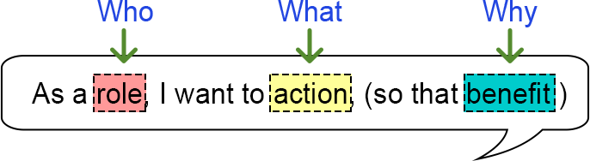
Recap: Writing User Stories
As a [customer], I want [shopping cart feature] so that [I can easily purchase items online].
As a [manager], I want to [generate a report] so that [I can understand which departments need more resources].
As a [customer], I want to [receive an SMS when the item arrives] so that [I can go pick it up right away]

Slide 17
Recap: Requirement Format
Standard form with hierarchical numbering
[identifier] The [noun phrase] shall (not) [verb phrase]
Standard form with hierarchical numbering and constraints
[identifier] The [noun phrase] shall (not) [verb phrase] [constraint phrase]
Example
1.2.1 The system shall reject untagged baggage within 5 seconds of identification

Slide 18
Recap: Requirements at multiple Levels
We need a user interface for the existing SARIMA forecasting Algorithm
1.1 We need a very simple user interface which allows user to input in a box all of the parameters of the algorithm
1.2 We need to host this (can use new effect website) or we can create another. It should act like a portal, user has user name and password. They log in, connect Xero / QB / Clearbook account and are able to use the prediction algo
1.3 We need the user to be able to write or rate the accuracy

Slide 19
Recap: Requirements at multiple Levels
1.1 We need a very simple user interface which allows user to input in a box all of the parameters of the algorithm
1.1.1 Forecast frequency should all be monthly
1.1.2 For manual excel upload; allow user to select the file from an explore dialog box
1.1.3 extract the sales and the date, transform into either pandas df and automatically run prediction

Slide 20
Recap: Types of Requirements
Business
User
Functional
Non-Functional

Slide 21
Requirements Documentation IEEE Standard for SRS Organized by Requirements
Introduction to the Document
1.1 Purpose of the Product
1.2 Scope of the Product
1.3 Acronyms, Abbreviations, Definitions
1.4 References
1.5 Outline of the rest of the SRS
General Description of Product
2.1 Context of Product
2.2 Product Functions
2.3 User Characteristics
2.4 Constraints
2.5 Assumptions and Dependencies
Specific Requirements
3.1 External Interface Requirements
3.1.1 User Interfaces
3.1.2 Hardware Interfaces
3.1.3 Software Interfaces
3.1.4 Communications Interfaces
3.2 Functional Requirements
3.2.1 Requirement 1
3.2.2 Requirement 2
…
3.3 Performance Requirements
3.4 Design Constraints
3.5 Other Quality Requirements
3.6 Other Requirements
Appendices
Functional Requirements for a Spellchecker:
Requirement 1:
System shall keep track of words being typed in the existing word processor
Requirement 2:
System shall check against each typed word if it is a valid word in the corresponding dictionary
Requirement 3:
System shall highlight the wrong words (i.e. which are not part of dictionary) while the user types in the existing word processor.
Requirement 4:
System shall give the user an option to make correction in case there is a wrong word typed
Requirement 5:
System shall suggest correct words when user opts to make a correction against a wrong word
Non Functional Requirements for a Spellchecker:
Requirement 1:
System shall integrate with an existing word processor that runs on Linux.
Requirement 2:
System shall use Red color to highlight the wrong words

Slide 22
Requirements Document
Customers (intended audience) of requirements document
Customers
Managers
Developers
Test engineers
Maintenance engineers
Other stakeholders

